Slide 1


IBM Watson + Qupplet
Innovation Labs
Karthick Raja

Slide 2



The global market for NLP is projected to reach
$10 Billion by 2020
Driven by the need to process the ever-growing volumes of unstructured data in corporate IT systems

Slide 3
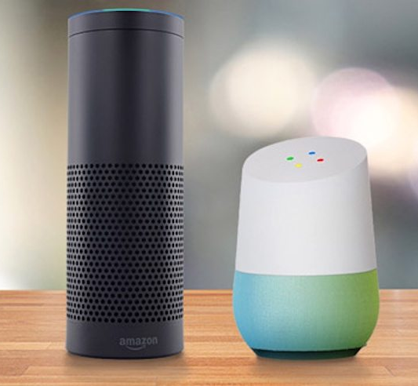
Using voice and natural language to command technology is no longer science fiction
Voice-activated natural language processing systems like Google Home and Alexa have made great inroads into the digital assistant market.

Slide 4




Search in Siebel is Tedious
Search is challenging for the Non Technical, it Requires Training
Search is Based on Keywords and Memorizing Query Syntax
Multiple Clicks and Navigation to Each Individual Screen

Slide 5



SoftClouds: We made Siebel better
Siebel + Qupplet – Get the best of both worlds......
…..Modern Technology to an Aging/Older System

Slide 6



Qupplet -“Google” for Siebel
Uses IBM Watson for Natural Language processing
No Query Syntax
Spell Checks, Timelines etc.,
Any query in just 3 clicks
Extract Relevant Information
Maintain User Access Control
Don’t Query… Ask Siebel!

Slide 7

DEMO

Slide 8







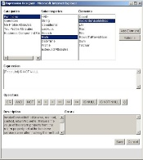



How it works - High Level Architecture
Natural Language Query
Enterprise – Siebel Instance
1
2
?
Search Question
Qupplet NLP Engine for Siebel
Plugin
User
4
Search Specification
5
6
3
Display Results
Siebel Database
User

Slide 9



Qupplet - Advantages
UI
It takes seconds to Produce a Search result
Lower cost of Search
Anyone can use it from Managers to Employees
No need to be Technical
Millennial Workforce is Accustomed to Modern UI
Higher Adoption Rate
Fast, Cost Effective
Easy to Use
Modern UI/UX

Slide 10



Qupplet – Product Features
Automatic Spell Checks
Automatic Timeline Checks
Today, Last week, Last Month, Last Year, etc.
Special Occasions
New Years, Halloween, etc.
Quick response time from NLP engine
Relevant information across databases and tables
Multiple Intent Queries for the User – Coming Soon
User Feedback
Exporting the Results

Slide 11


Qupplet- Overview
User
Management
Siebel UI
Reporting
UI
Batch Interface
Question
Interface
Qupplet Engine
User DB
Qupplet
DB
Logs
Dictionary
Questions

Slide 12
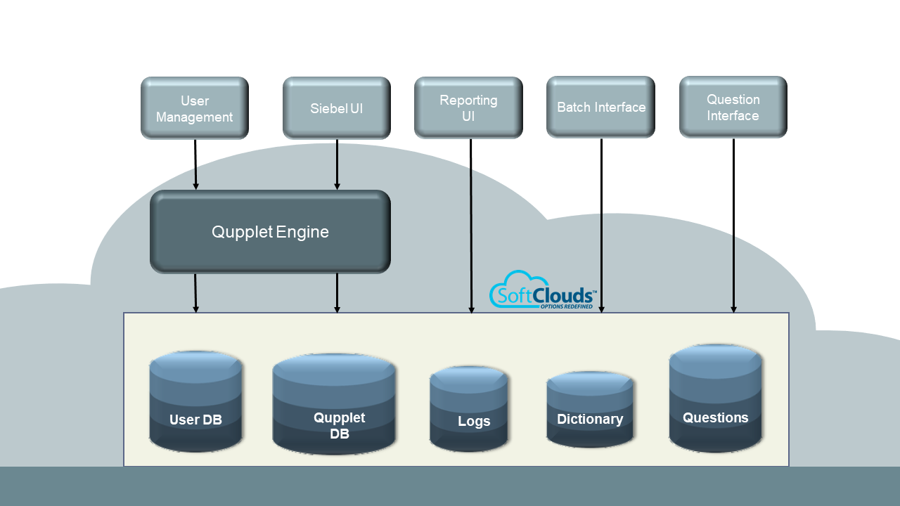
Overview
Siebel UI:
Frontend Siebel application where end users can make queries in natural language.
Batch Interface:
Interface to make sure that Qupplet provides correct results for all questions.
Question Interface:
An interface for users to crowd source user questions so that Qupplet can be “perfected” to make sure that all questions are properly answered.
User Management:
To control the number of licensed users and client.
Reporting Interface:
To provide the detailed statistics & Reporting interface for Qupplet.
Qupplet Engine:
The core engine that takes natural language queries and responds with the exact Siebel search specification.
Qupplet DB:
Tracks user actions and responses for reporting and analytics.

Slide 13
Qupplet : Technical Overview
AWS Cloud
IBM Cloud
Qupplet
User Management
&
Reports Application
Qupplet
Cloud
Engine
Conversational API
:Java
:Node JS
On-premise
Siebel
User
Dictionary
Tomcat
MySQL
Logs
Test
NLU API
(Natural Language Understanding API)
Linux

Slide 14

Technical Overview
Siebel sends the query request to Qupplet AWS cloud-based application.
Qupplet sends the XML request to IBM Watson cloud-based application to manipulate the query for natural language processing after spell check.
Qupplet gets the response from IBM Watson and manipulate the exact search spec to be queried over.
Qupplet sends back search spec to Siebel.
Siebel generates the SQL for the search spec and renders the result in UI.

Slide 15
Qupplet- Processing
AWS
IBM Watson
NLP
Qupplet
Engine
Spell
Check
Qupplet
NLP
Processing
Create
Search Spec
& Log
Return
Result to Siebel
NLU -
Standard
NLU - Custom

Slide 16

Qupplet- Process
Question/Query will be raised from the Siebel application user interface
Qupplet Engines does the Authentication
Qupplet Engine does Spell check
Qupplet Engine passes the query to IBM Watson for NLP
Conversation UI API’s used for Intent (example Sales, service request etc.,)
NLP API used for Entity processing (names, dates, location etc.,)
Responds back to Qupplet Engine
Qupplet Engine takes the Watson Output, does more NLP processing to understand query
Qupplet Engine generates a search spec
Log the Query, search spec, user and other details in Qupplet DB
Respond back to Siebel with search spec
Siebel creates SQL Statements from search spec
Siebel executes the SQL search based on the search spec and displays result in Siebel end user interface

Slide 17
Components
Siebel Applet - Query Interface | Get Search String, initiate processing
Siebel Applet - Data Query | Gets Search Spec from Engine, creates SQL Query, sends query to Siebel for Data visualization
Authentication | An admin interface to add/edit/delete/enable/disable users
Qupplet Engine | Processes Search String, uses Watson, creates & returns Search Spec
Logger | Logs all searches by user/string/search spec
Qupplet Version Upgrade test interface | Shows and can append logs to golden master (has string, responses) Reports results and compares against golden master, runs in Batch Mode
Reporting Interface | User Interface for Reports and Analytics Visualization

Slide 18
Interfaces
Siebel UI | Client Siebel application where the end user making queries in natural language.
Batch Interface | User Management interface to make sure that giving the correct result from all the questions
Question Interface | It’s a question bank where we can save the n number of questions and Qupplet engine will make sure that all the questions are properly answered.
Client Management | To manage the license for n number of clients
User Management | To control the number of licensed users and client.
Reporting Interface | To provide the detailed statistics about each query which has been entered in Qupplet log.

Slide 19
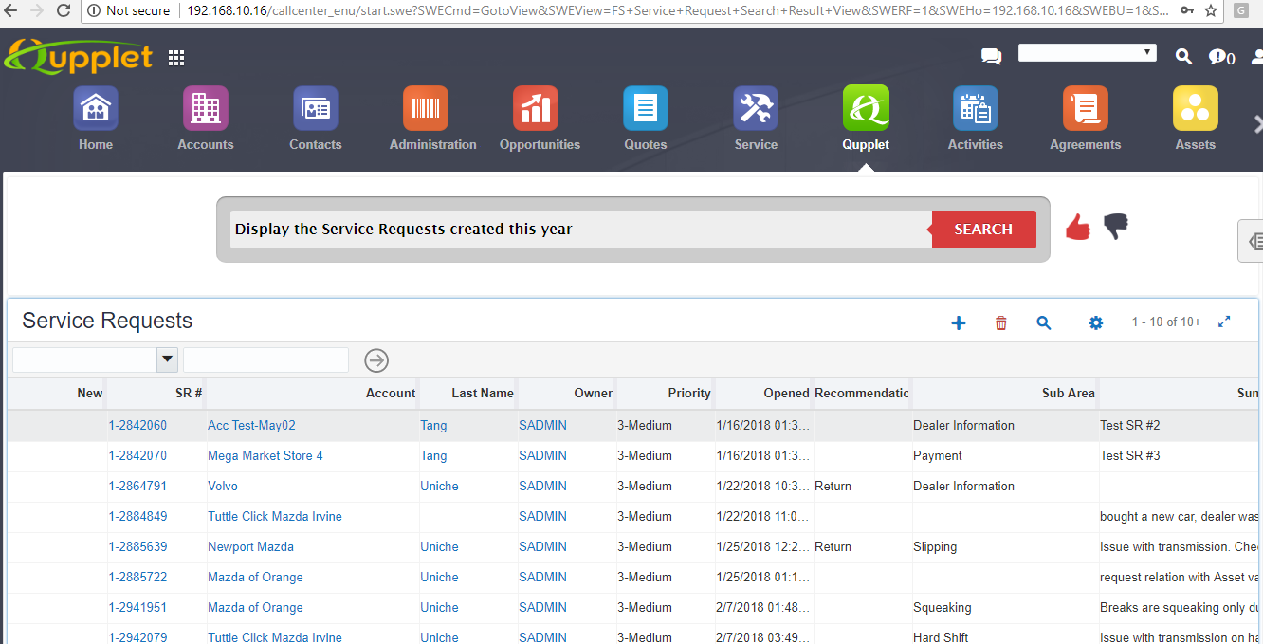
Siebel UI
Siebel Open UI
User Interface Search Screen for providing natural language questions across the business objects and retrieving the results.

Slide 20

Siebel UI
http://192.168.10.16/callcenter_enu/start.swe
Credentials: sadmin/sadmin
Admin Credentials: venkat Vakiti/venkatv

Slide 21
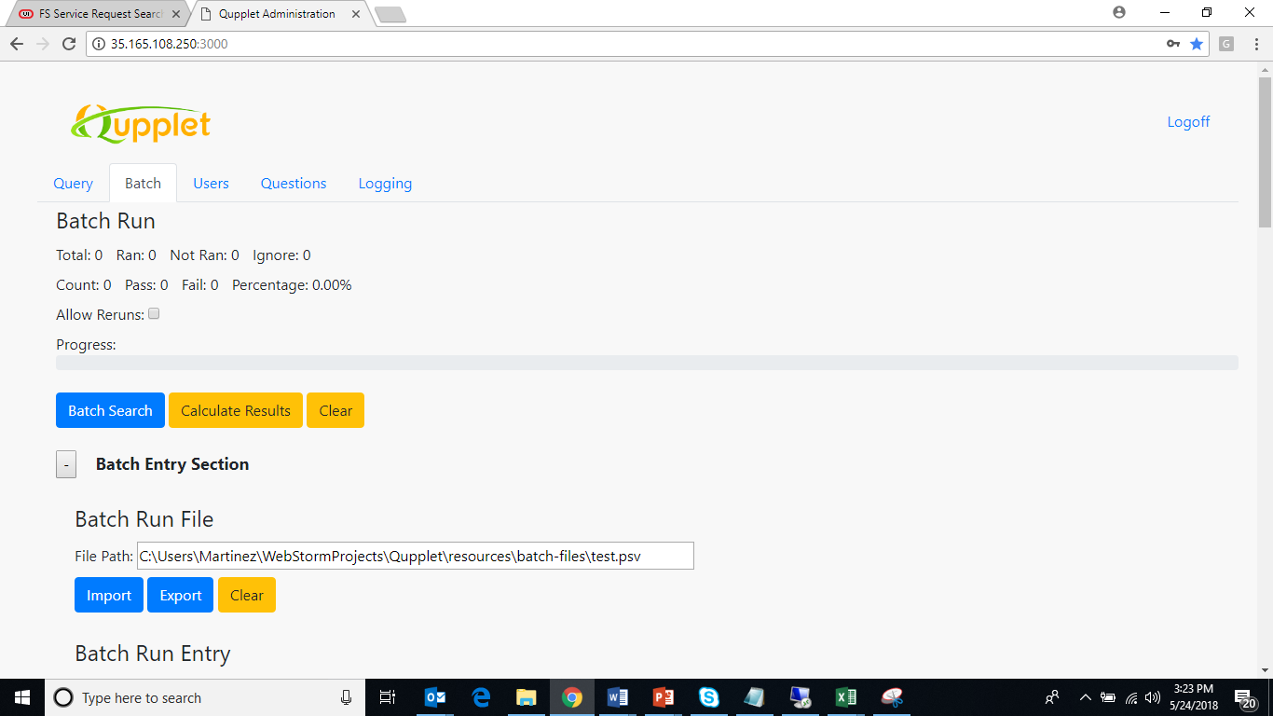
Batch Interface
Batch Interface to import/export questions from/to a file

Slide 22
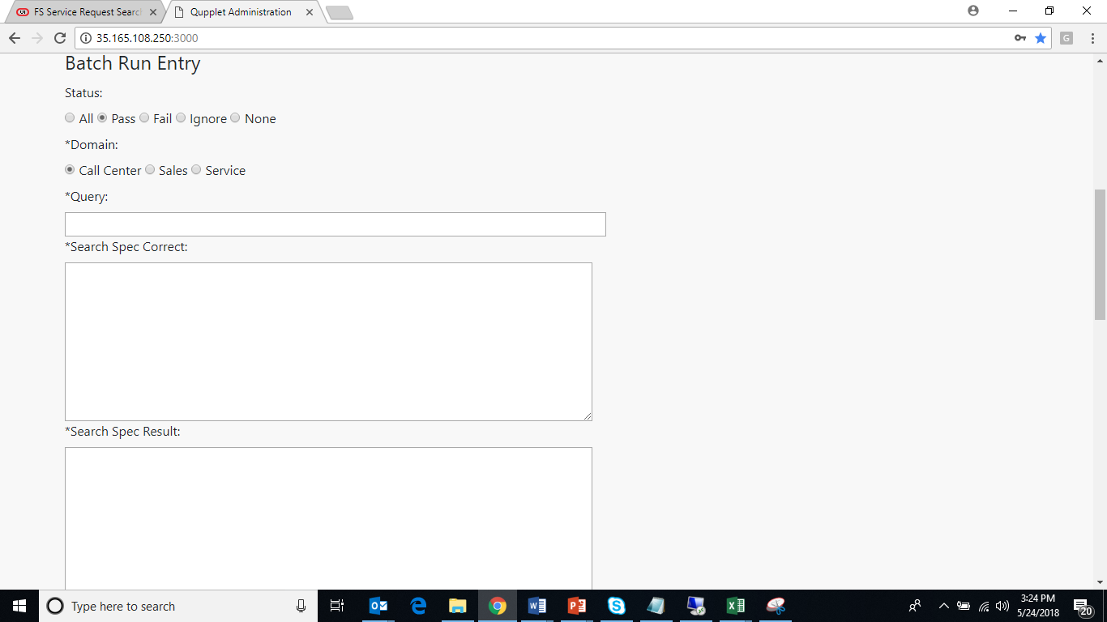
Batch Interface
Batch Run Interface to check and confirm whether questions are being processed successfully and provide the correct results.

Slide 23
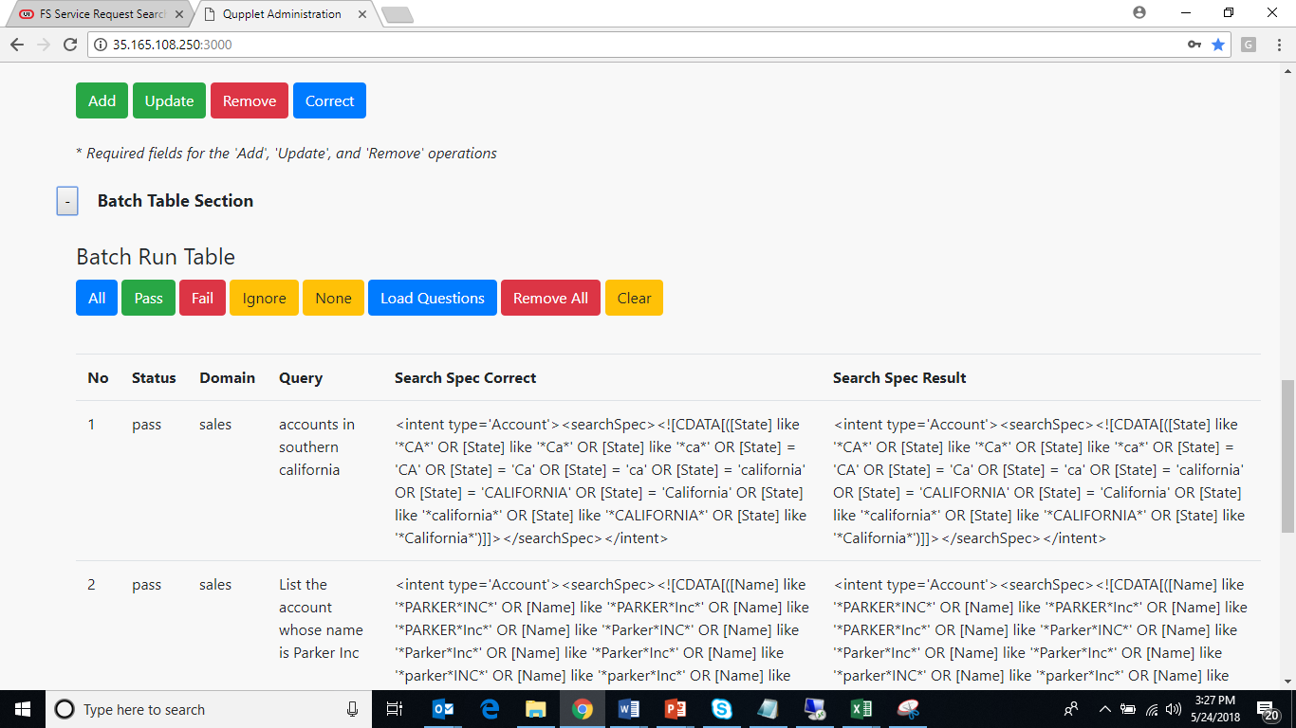
Batch Interface
Batch run table showing the results of the questions processed.

Slide 24

http://35.165.108.250:3000/
Credentials: sadmin/66879938967453217356
Batch UI
Admin Credentials: venkat Vakiti/venkatv

Slide 25
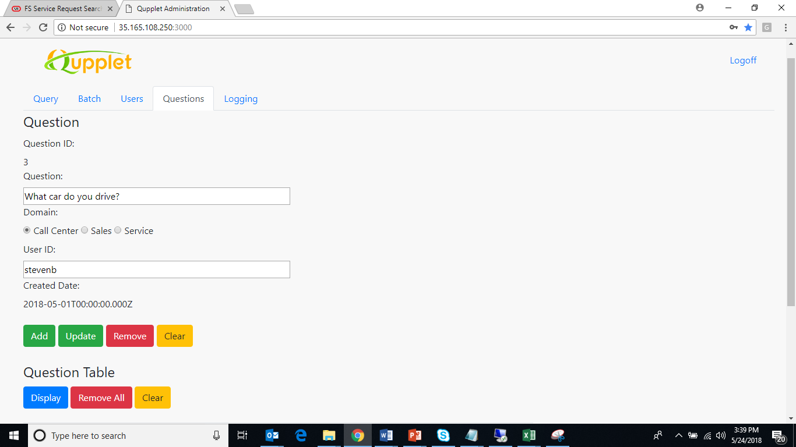
Question Interface
Questions can be collected manually to the question bank to check whether Qupplet is providing accurate results.

Slide 26

Question UI
http://35.165.108.250:3000/
Super Admin Credentials: sadmin/66879938967453217356
Admin Credentials: venkat Vakiti/venkatv

Slide 27



Client Management – by Super Admin
To manage the license for n number of clients
As a Super Admin
Able to see/edit/all data with respect to clients, admins
Able to add clients + licenses
Able to add admins to clients
As an Admin
Able to see only the client and the admin details.

Slide 28
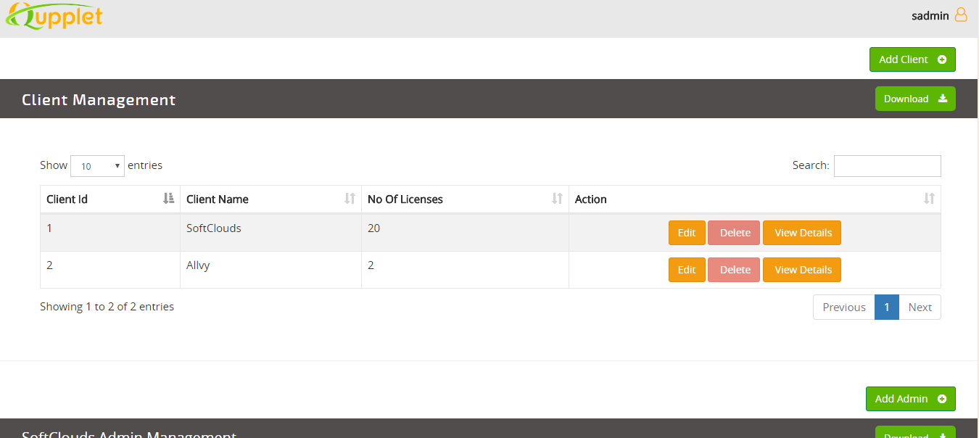
Client Management – by Super Admin
Handle licensed clients effectively.

Slide 29
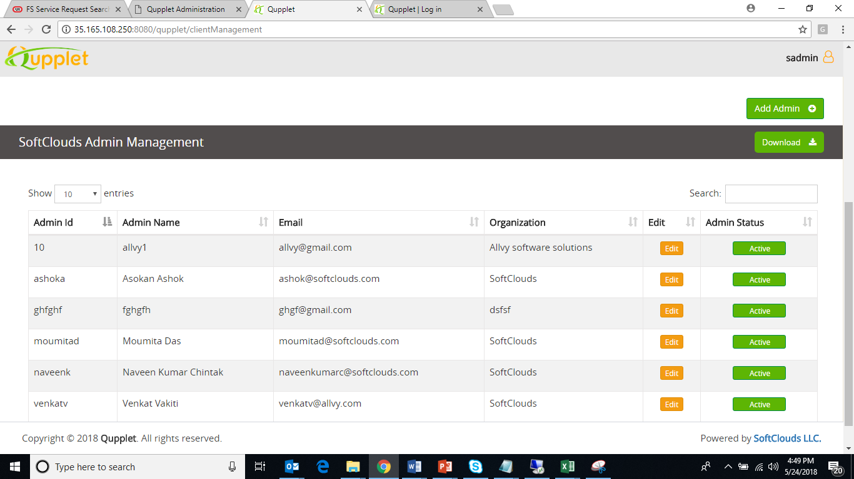
Client Management – by Super Admin
Handle licensed clients effectively.

Slide 30
http://35.165.108.250:8080/qupplet/clientManagement
Super Admin Credentials: sadmin/66879938967453217356
Admin Credentials: venkatVakiti/venkatv
Client Management

Slide 31

User Management
To control the number of licensed users.
As a Super Admin
Add/Edit/Delete all the licensed admin users for each client.
Have a drop down to pick the client name
Once picks the client name – See all that the “admin” can see – i.e. all users for that client
As an Admin
Add/Edit/Delete the licensed users for the client allocated for the admin.
Able to see only the licensed users allocated for the client.
Able to add number users allocated for the client only.

Slide 32
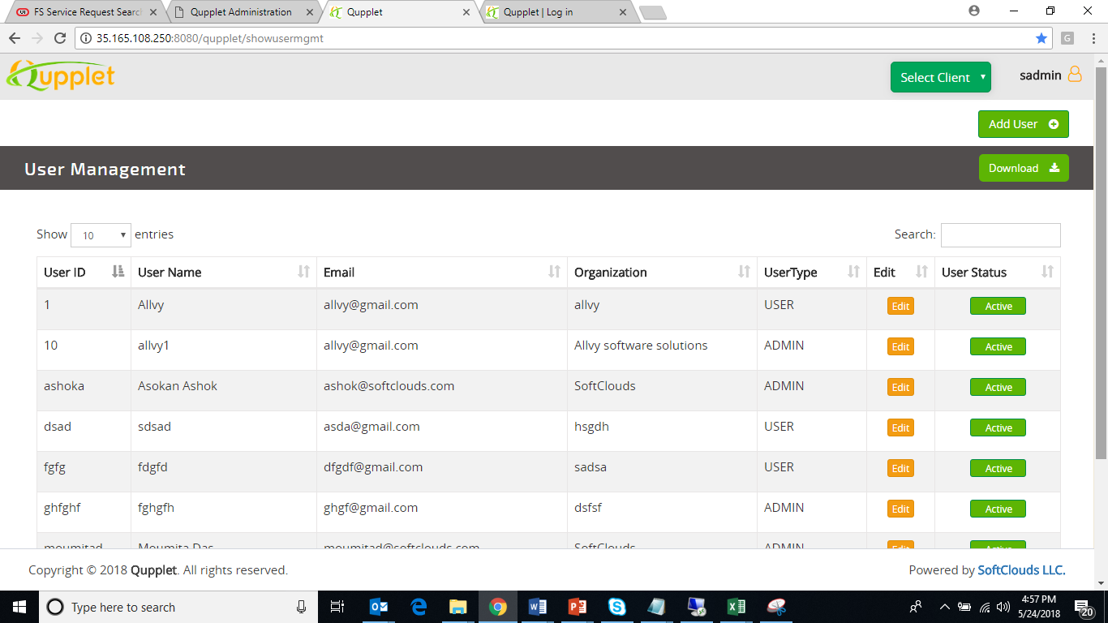
User Management
Add/Activate/Deactivate the users for each client.

Slide 33
User Management
http://35.165.108.250:8080/qupplet/showusermgmt
Super Admin Credentials: sadmin/66879938967453217356
Admin Credentials: venkat Vakiti/venkatv

Slide 34




Report Interface
To provide the detailed statistics, analytics and reports visually.
Reports have been categorized
By User
By Date
By Query Process
By Query Result
As a Super Admin
By Default all reports will be available for all the clients.
Once client name is picked – all reports for that client will be available.
As an Admin
Only able to see the reports for the client.

Slide 35
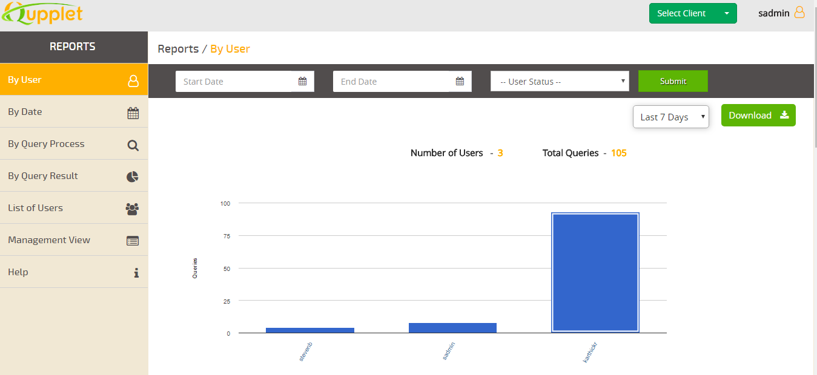
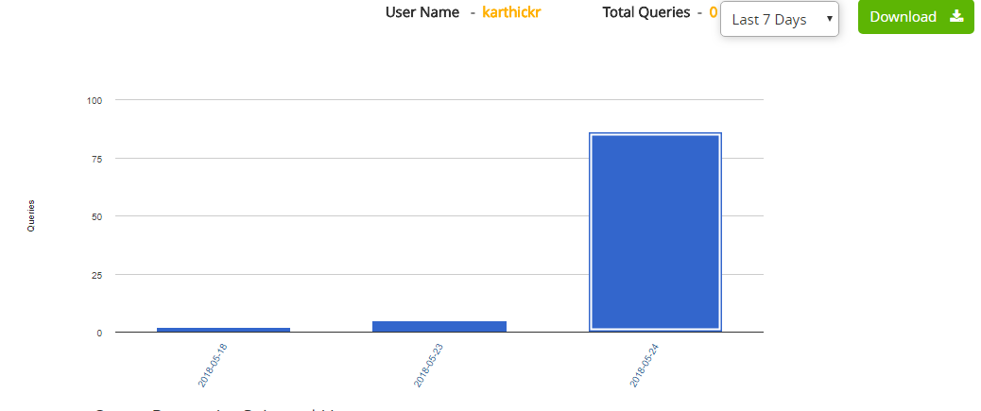
Reports – By User

Slide 36
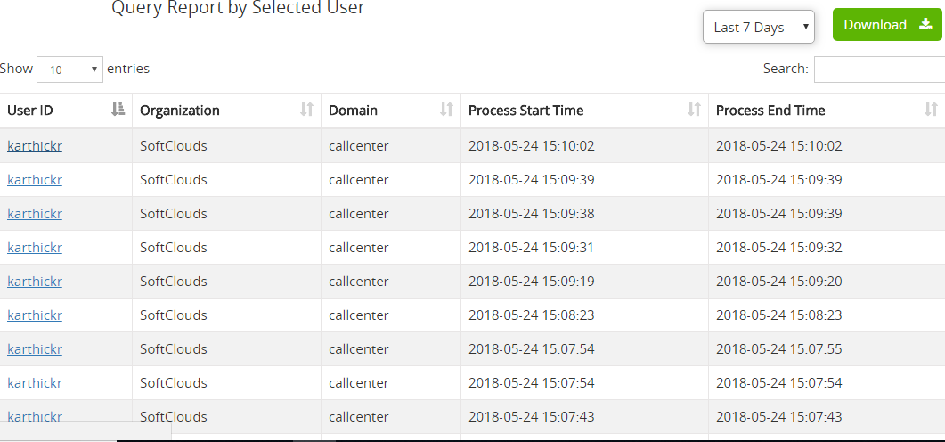
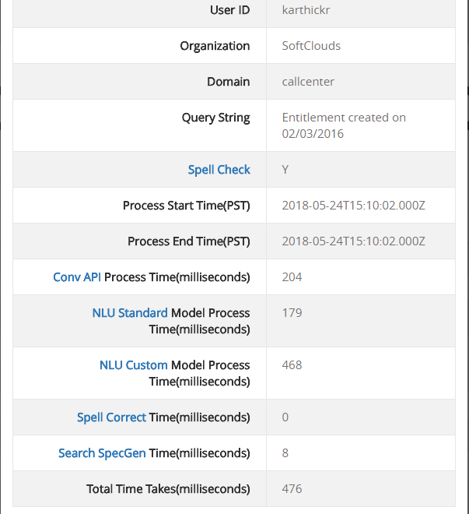
Reports – By User

Slide 37
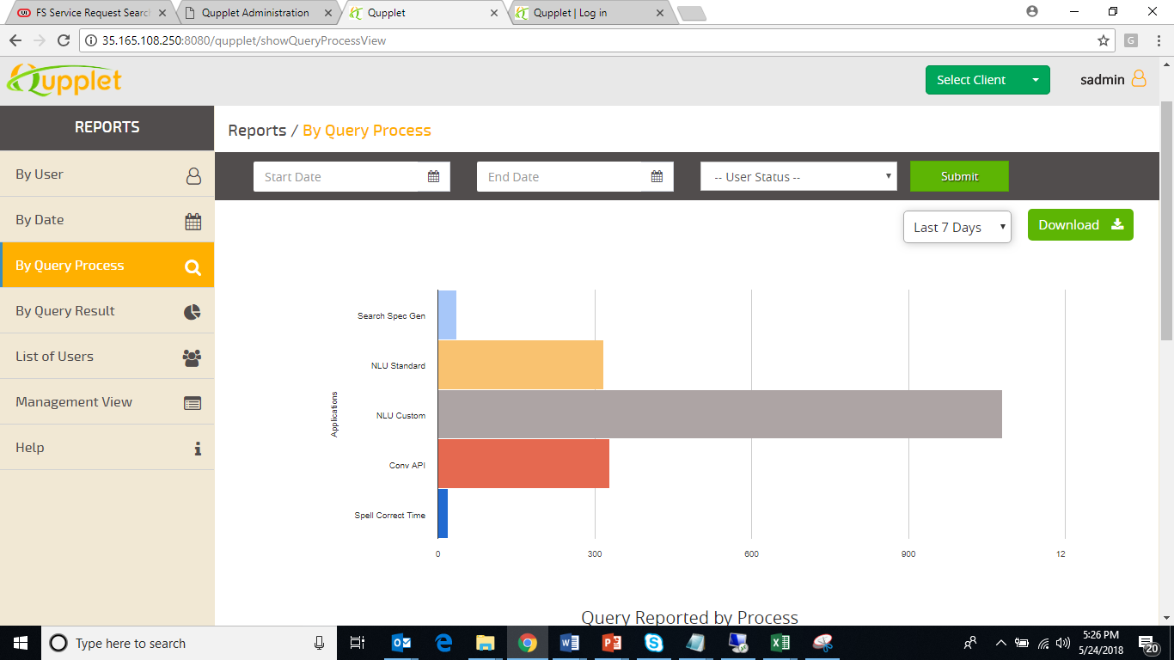
Reports – By Query Process

Slide 38
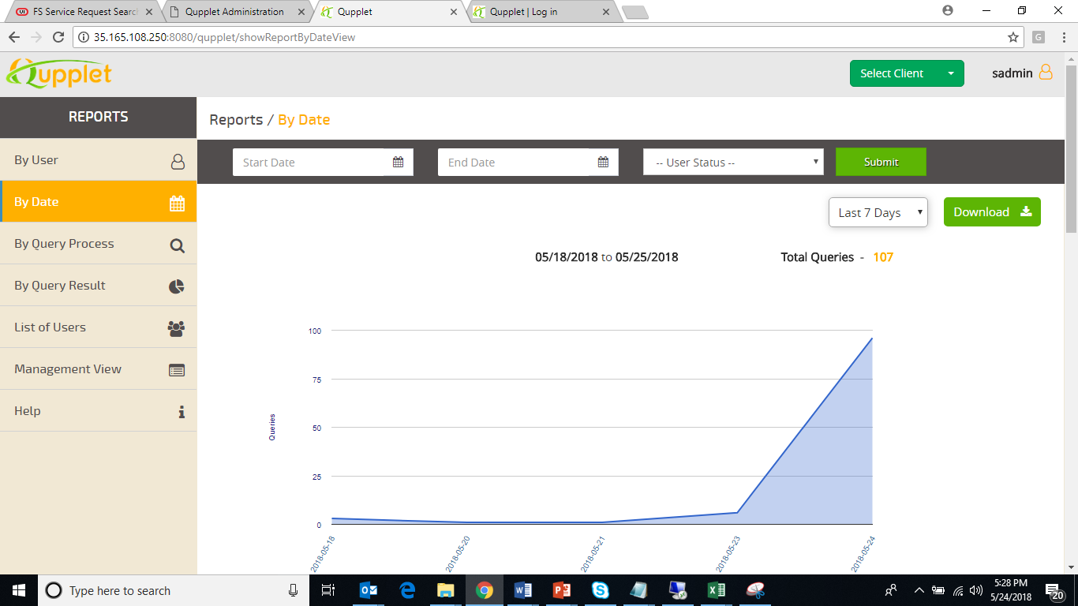
Reports – By Date

Slide 39
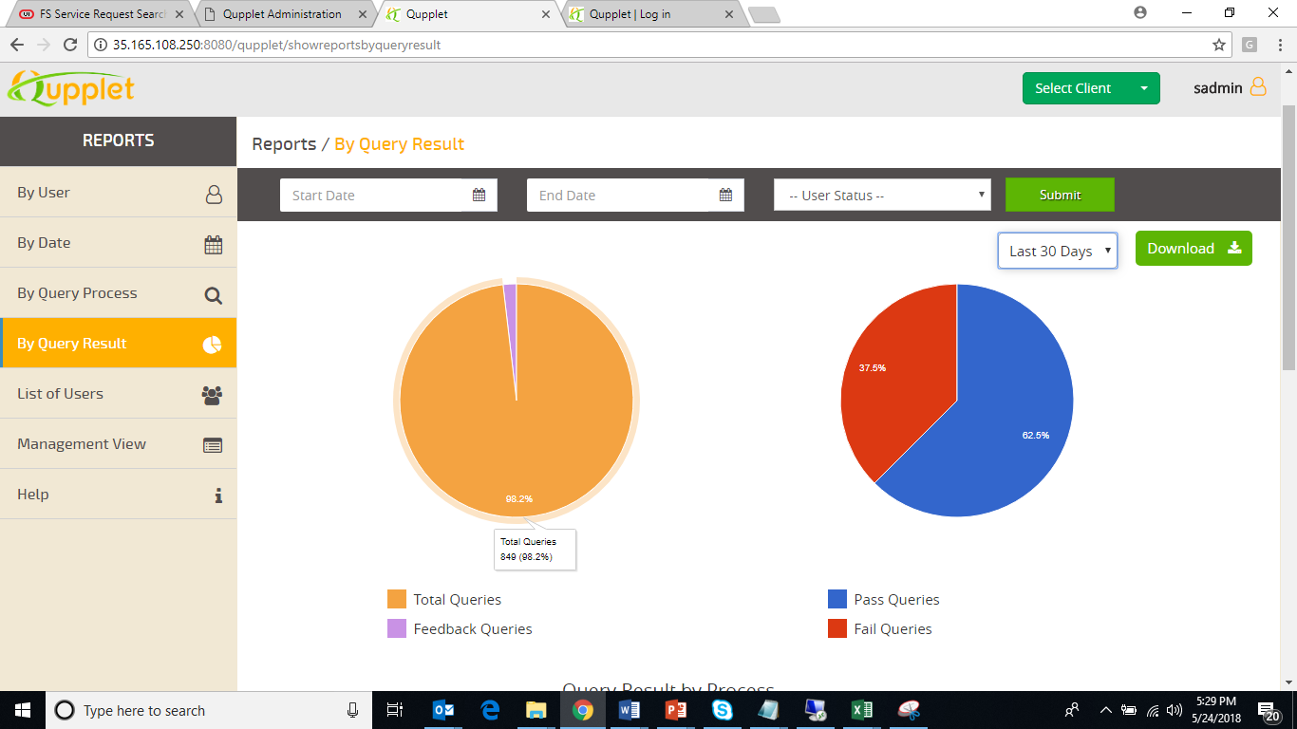


Reports – By Query Result

Slide 40
Report Interface
http://35.165.108.250:8080/qupplet/getqueryreportsbyuser
Super Admin Credentials: sadmin/66879938967453217356
Admin Credentials: venkat Vakiti/venkatv

Slide 41
Authentication
Company Management by Super Admin (SoftClouds)
Company id
Company password
Admin Interface to manage users
Add new users
Edit/delete/enable/disable users
Reset password
User details
User id
User Password
Email address
Status <enabled/disabled>
Analytics & Reporting
Admin can see the top users by search
Admin can see the search strings,, results
Dashboard of users (by time, date etc.,)

Slide 42

Logging
Has a golden master of all queries, search spec
Has a log of all queries –
date/time
User id on who queried
Query String
how long it took to NLP
Search spec created
Analytics/Report Generation

Slide 43
Deployment Plan
&
Needs from Mazda

Slide 44

Questions into Question Interface
Though we have done for Call Center and sales applications on the out of the box entities such as Account, Contacts, Opportunity, Service Request and so on, It would be good to have the standard and customized entities going to be added by MAZDA.
Initially we need to get some model questions across the customized entities in MAZDA.
Get the common queries from the end users would be more helpful to evaluate with Qupplet question interface.
May be we can start with all the PDQ predefined queries stored in the Siebel application.
Need: Need Mazda Users to add questions into the Qupplet Question Interface for us to make sure that all possible queries are processed

Slide 45
Need from MAZDA to start the Qupplet Customization
Should have a table of Data Dictionaries for MAZDA technical terms
Contact may mean something for sales, different meaning for service
Dynamic loading of data from data dictionary based on query
Hence we need to have MAZDA standard and customized objects and fields which needs to be configured in Qupplet data dictionary to make the accurate search engine results.
Repository access to check the standard and customized modules and the corresponding fields to be mapped with qupplet engine.
App Server access to customize the open UI changes to design the qupplet search page.
Need: Repository details & app server access

Slide 46



White Label Qupplet
Mazda might want to call Qupplet as any other name
Need to finalize name
Come up with logos/color schemes
Search Query Database from users/requirements
Need: Name, Logo & color Scheme if Mazda wants the change name/color/icon

Slide 47
Qupplet Integration into Mazda Siebel
MAZDA app server need to send the question to qupplet AWS server for NLP – Natural Language Processing.
Qupplet AWS server receives the question and responds with the exact search specification to be queried over in Siebel application.
MAZDA app server would receive the search specification and executes the same for giving the exact result in the search page.
Hence MAZDA/ Qupplet AWS servers needs to be integrated to send/receive data accordingly
Need: Repository details & app server access

Slide 48
Qupplet Beta Testers
Once all the configuration is done, MAZDA pilot users can start the testing and give the feedback for the beta version.
If any feedback, Need to incorporate all the feedback and release it into production.
Need to give the warranty support after the production LIVE, as per the agreement.
Need: Pilot testers from MAZDA for testing the Beta version

Slide 49
Project - Team
Name | Role | Responsibility
Asokan Ashok | Product Owner | Delivery of Product, Features, Product Management
Mike Downing | Project Manager | Project Schedule & Meets Customer Requirements
Karthick Raja | Architect | Architecture, Design and Deployment, Support/Warranty and Customer Interface
Steve Burns | Software Engineer | Design/Development
 | Tester | QA/testing

Slide 50

Thank Yo
U

Slide 51




www.softclouds.com
ashok@softclouds.com
Follow us on

